Slide 1

SCPI, Inc.
Group Project Summary
December 11, 2017
CIS 485

Slide 2
Developers
Yoko Nakano – Front End, Back End, Database, Graphics
Nirajan Paudel – Database
Triston Powell – Database
Mike Robinson – Front End, Back End, Database, Graphics
Mike Gordon – Front End
Roxanne Thwaites - Summary

Slide 3
Application – Celebrity Death Match
Overview
Celebrity Death Match is a single player game app.
It allows users to select their favorite celebrity movie super hero characters, and have them face off and compete in a battle to the death!
There are a total of 20 characters in which to choose from.
The game will require users to create a Login in order to play, and it will also allow them to register credit card information to purchase game coins.
The game stats will tell users how well their characters have done, by showing them the number of wins or deaths.

Slide 4
Page Structure
The page structure contains the following information:
Index (Home)
Navigation (Home, Title of Page )
How to play
Stat
Registration
Login Form
Buy Coins
Pictures of Characters (20 in total to choose from)

Slide 5
Page Structure (cont.)
2. Sign Up (Allows users to create an account with the following information)
First Name, Last Name
Email address
Username
Privacy Policy

Slide 6
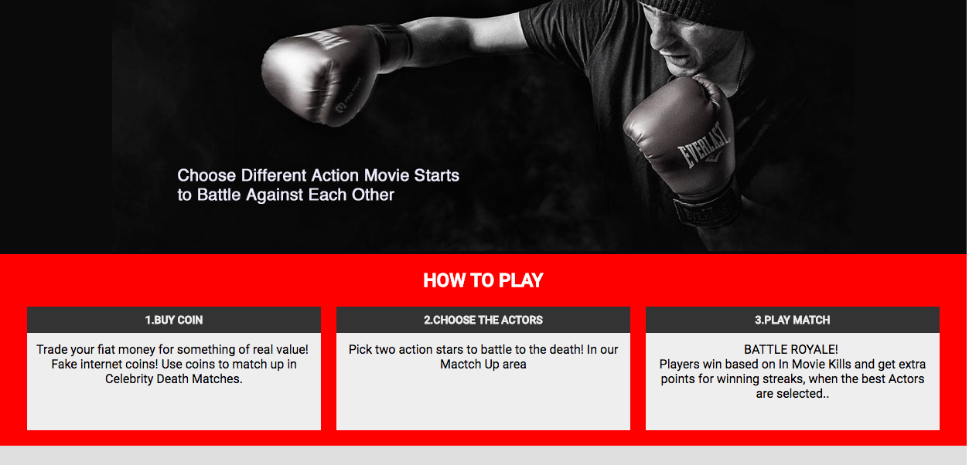
Sample Index page

Slide 7
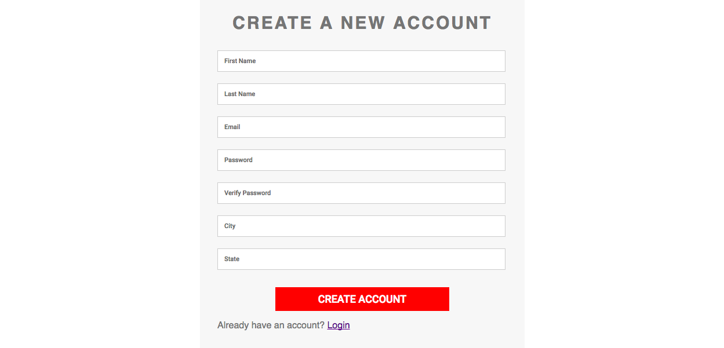
Sample Registration Page

Slide 8
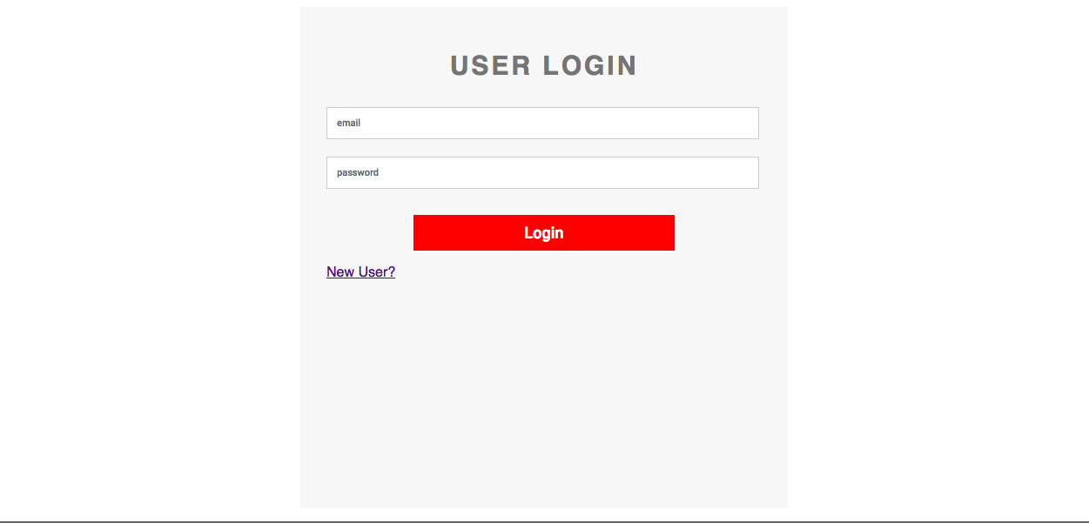
Sample Login Page

Slide 9
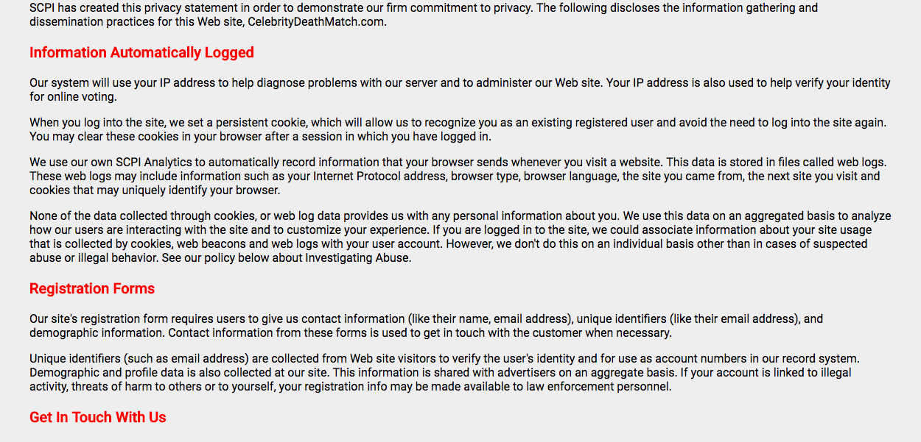
Sample Privacy Policy

Slide 10
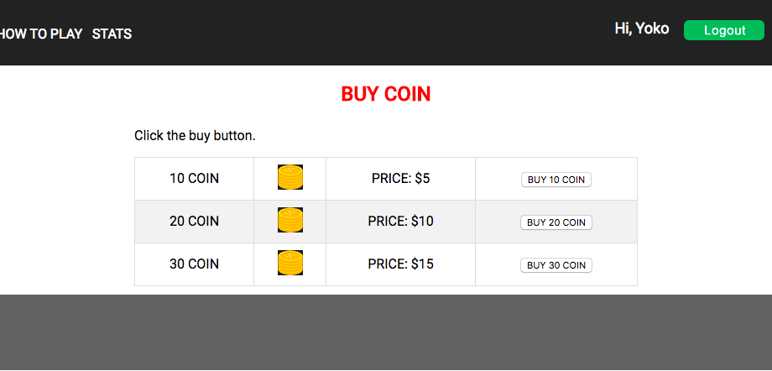
Sample Shopping Cart (purchase Coins)

Slide 11
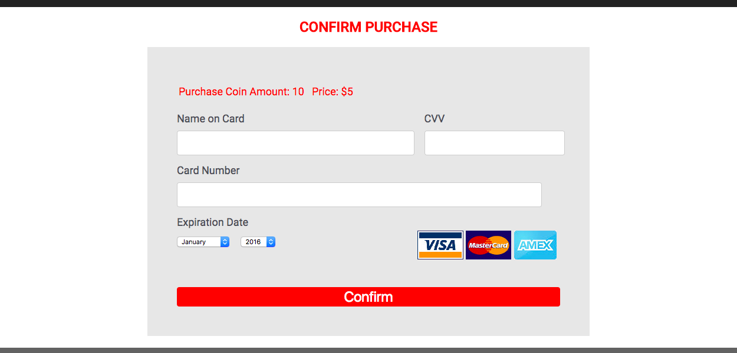
Sample Shopping Cart (Credit Card registration)

Slide 12
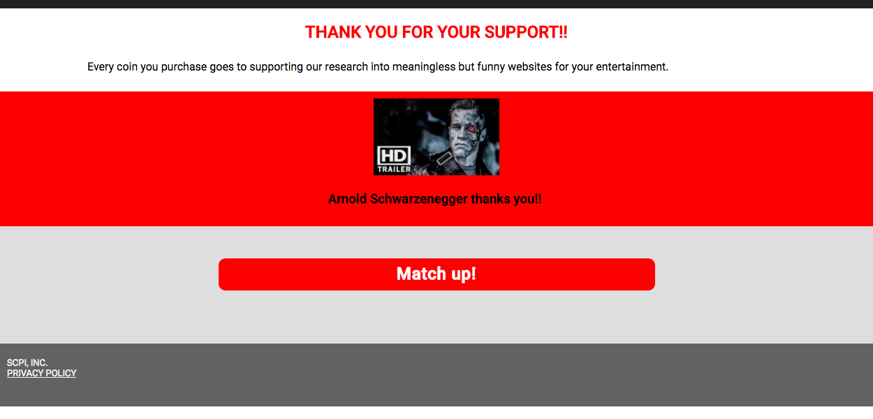
Sample Shopping Cart (purchase confirmation)

Slide 13
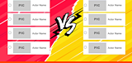
Sample Match up Page

Slide 14
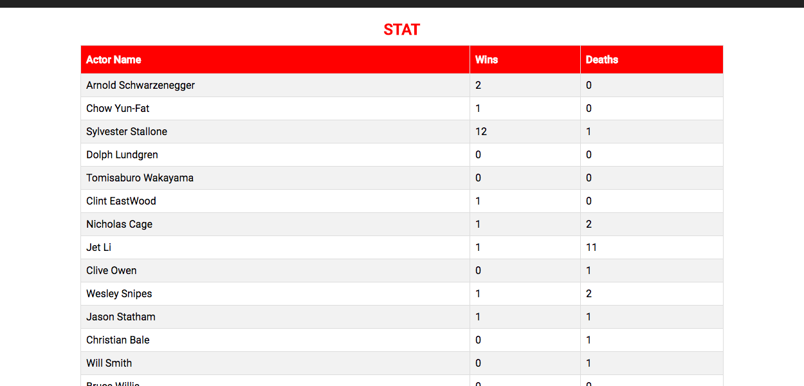
Game Stats

